Slide 1
GERD FOLLOWING SLEEVE GASTRECTOMY & RYGB: IS THERE A WAY TO PREVENT IT?
Dott.ssa Lavinia amato
s.c. chirurgia generale
p.o. citta’ di castello-pg
(resp. Chirurgia bariatrica: dott. alessandro contine)

Slide 2
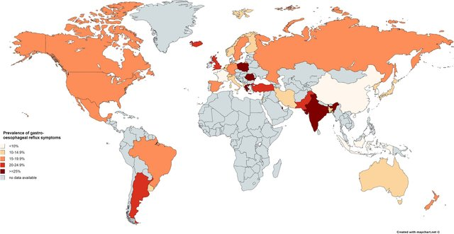
“The overall burden of GERD continued to worsen with the prevalent cases increasing by 77.53% from 441.57 million in 1990 to 783.95 million in 2019.”
“BMI is associated with GERD symptoms in both normal weight and overweight individuals. Our findings suggest that even modest weight gain among normal weight individuals may cause or exacerbate reflux symptoms.”
“Based on endoscopic and histopathologic appearance, GERD is classified into three different phenotypes: non-erosive reflux disease, erosive esophagitis, and Barrett’s esophagus ”
10–15% of patients with gastroesophageal reflux disease will develop Barrett’s esophagus and 50% of subjects with Barrett’s or esophageal adenocarcinoma will report no history of gastroesophageal reflux symptoms”
Eusebi LH, Ratnakumaran R, Yuan Y, Solaymani-Dodaran M, Bazzoli F, Ford AC. Global prevalence of, and risk factors for, gastro-oesophageal reflux symptoms: a meta-analysis. Gut. 2018 Mar;67(3):430-440.

Slide 3
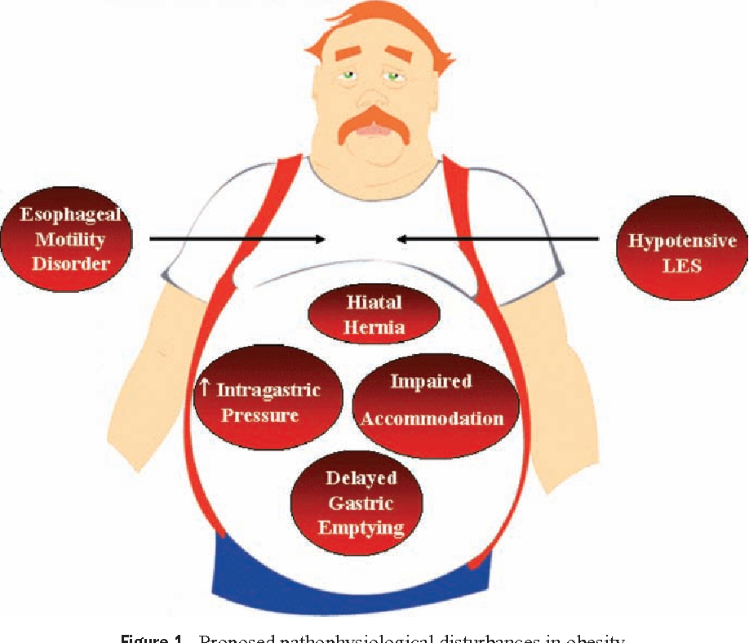
Jacobsen et al reported that increasing BMI for >3.5 points compared to no weight change increases the risk of developing GERD and the frequency of related symptoms.
Long term complications including erosive esophagitis, Barrett’s esophagus and esophageal adenocarcinoma are associated with Obesity.
Associations of Barrett’s and obesity have been demonstrated by Stein and others who established that for each 5-unit increase in BMI, the risk of Barrett’s increased by 35%.
Abdominal obesity (“central obesity”) has been shown to be a more specific risk factor for Barrett’s.

Slide 4
MECHANISMS OF REFLUX
Hiatal hernia, a short intraabdominal esophagus, weakness of the diaphragmatic crura/phreno-esophageal ligament, or elevated intraabdominal pressure are important risk factors in the development of GERD.
Central Abdominal obesity can raise intraperitoneal pressure significantly increasing intragastric pressure and transient relaxations of LES which become inappropriate to the gastric volume

Slide 5
REFLUX MECHANISM FOLLOWING SLEEVE GASTRECTOMY
2/3 gastrectomy of the body and fundus of the stomach are removed and it’s typically performed over a calibration tube. The size of tube does not correlate with weight loss, but does correlate with symptoms of reflux.
The permissive reflux state post Sleeve Gastrectomy can be explained by a number of anatomic and functional changes:
blunting of the angle of His;
intrathoracic migration of the gastric tube resulting in de novo hiatal hernia formation;
resecting the greater curvature reduces gastric compliance, resulting in an increase in intragastric pressures and provoking an increase in transient lower esophageal sphincter relaxations;
disruption of the antral pacemaker and autonomic connections can result in reduced contractions and decreased gastric accommodation;

Slide 6
SLEEVE GASTRECTOMY AND REFLUX
Meta-analysis found that the incidence of postoperative GERD after sleeve was 19%.
de novo reflux was 23%.
The long-term prevalence of esophagitis was 28%.
Barrett’s Esophagus was 8%.
4% of all patients required conversion to RYGB for severe reflux.
SURVEILLANCE AFTER SLEEVE ???
It remains unclear whether pts who develop new or worsening reflux should be submitted to some manner of surveillance!!

Slide 7
REFLUX MECHANISM FOLLOWING RYGBP
Roux-en-Y gastric bypass appears to have the most beneficial effect on GERD
LRYGB diverts bile and the bulk of acid away from the gastric pouch and esophagus due to the long Roux limb
very little acid is produced in the cardia-based gastric pouch.
surgically induced weight loss may diminish systemic inflammation, which may contribute to improvement in metaplastic changes in the esophagus
BARRETT’S AND GASTRIC BYPASS
Patients with erosive esophagitis had a statistically significant resolution after RYGB.
• Barrett’s esophagus was improved or even resolved in many patients without acquiring significance and appears to prevent progression.
Long-term surveillance data is necessary to define the certain evolution of EE and BE after GBP.

Slide 8
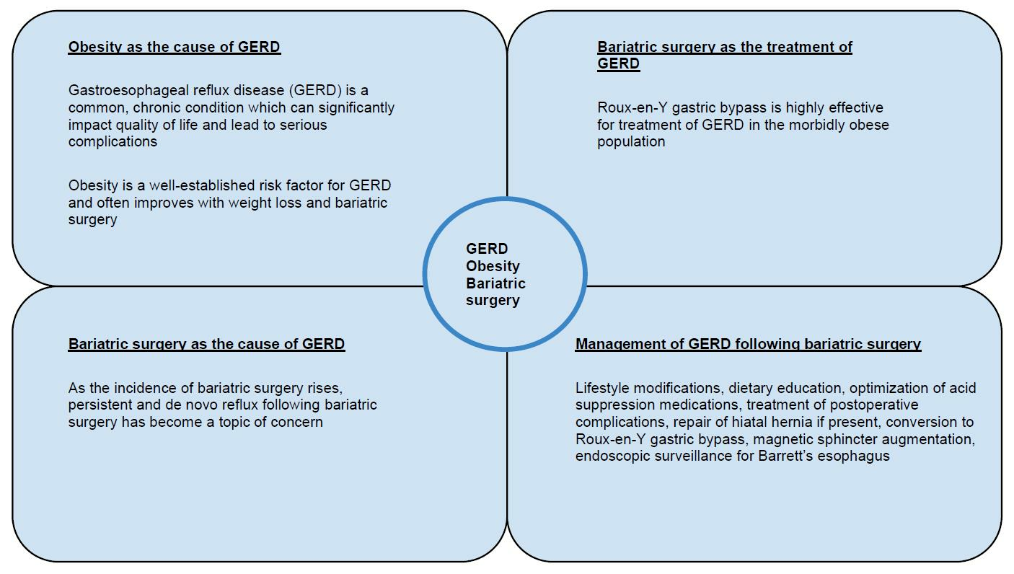
BARIATRIC SURGERY AS BOTH THE CAUSE & THE CURE OF GERD

Slide 9
With the recent rise in bariatric surgery, especially SG, persistent and de novo reflux following bariatric surgery has become a topic of concern.
Management of post-bariatric surgery GERD includes lifestyle modifications, optimization of PPI and H2RAs, treatment of postoperative complications and repair of hiatal hernia if present.
Conversion to Roux-en-Y currently has the most robust evidence to support its safety and efficacy for the treatment of medically refractory GERD post-SG.
Other options include magnetic sphincter augmentation, though data regarding safety and efficacy are limited.

Slide 10
Currently and going forward, more precise, standardized methods are warranted to document GERD following bariatric surgery, due to the variability in the reported literature. As bariatric surgery can be both the cure and the cause for GERD in the morbidly obese population, careful patient selection and proper surgical technique are paramount for a favorable outcome.

Slide 11
«…Bariatric Redo-surgery may improve GERD symptoms in obese pts who underwent laparoscopic sleeve gastrectomy; however, the most favorable effect is likely to be found after Roux-en-Y gastric bypass surgery…»

Slide 12
WHAT ABOUT GERD FOLLOWING RYGB???
«…Although the majority of patients with GERD after RYGB can be effectively managed with medical therapy, some may require endoscopic or surgical treatment. Critical technical elements of RYGB should be considered to reduce the risk of postoperative GERD…»

Slide 13
«…The presence of GERD might represent a relative contraindication for sleeve gastrectomy or gastric banding or both. Gastric bypass might be the procedure of choice in morbid obese patients with GERD symptoms or findings or both…»
WHAT IF RYGB ISN’T POSSIBLE?
«…Compared with LSG, LRYGB had a better effect on GERD (OR = 0.19, 95% CI 0.12-0.30, p < 0.001).
LRYGB was more effective for treating GERD in obese patients than LSG and the incidence of newly onset GERD after LRYGB was lower…»

Slide 14
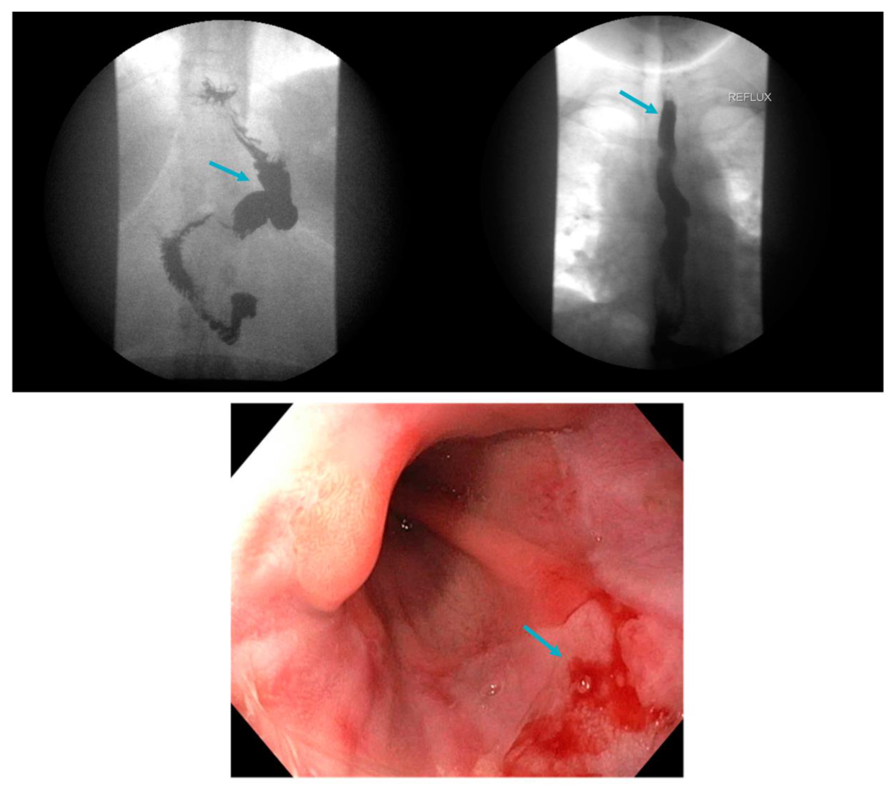
On multivariate analysis, the strongest predictors of GERD after SG were endoscopically identified esophagitis (odds ratio [OR] 2.79; 95% confidence interval [CI]1.17-6.69; p = 0.02) and biopsy-proven esophagitis (OR 2.80; 95% CI 1.06-7.37; p = 0.04). Male patients were less likely to develop GERD after SG (OR 0.23; 95% CI 0.06-0.85; p = 0.03).
«…Conclusion: Our findings strengthen the rationale for routine preoperative endoscopy and highlight critical clinical and endoscopic criteria that should prompt consideration of alternatives to SG for weight loss…»

Slide 15
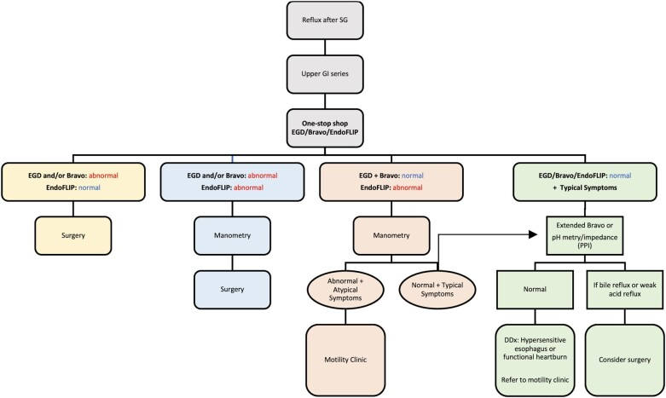
THE IMPORTANCE OF EGD!!!
EGD: esophagogastroduodenoscopy
Figure 1. Algorithmic approach for the evaluation and management of GERD after SG. GERD, gastroesophageal reflux disease; SG, sleeve gastrectomy; GI, gastrointestinal; EGD, esophagogastroduodenoscopy; PPI, proton-pump inhibitor; DDx, differential diagnosis.

Slide 16
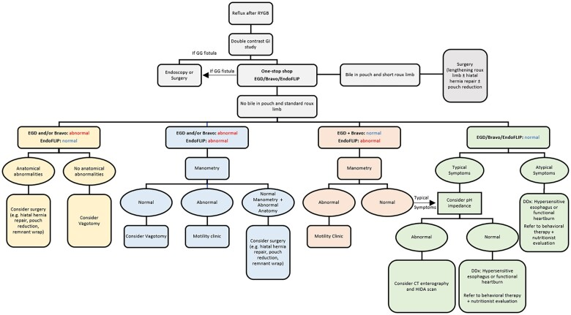
THE IMPORTANCE OF EGD!!!
Figure 2. Algorithmic approach for the evaluation and management of GERD after RYGB. GERD, gastroesophageal reflux disease; RYGB, Roux-en-Y gastric bypass; GI, gastrointestinal; GG, gastrogastric; EGD, esophagogastroduodenoscopy; CT, computed tomography; HIDA, hepatobiliary iminodiacetic acid; DDx, differential diagnosis.
EGD: esophagogastroduodenoscopy

Slide 17
A POSSIBILE INDICATION???
In OUR EXPERIENCE (May 2017 to date), 143 cases of laparoscopic Sleeve Gastrectomy & 45 RYGB were performed:
1 pt coming from another Institution affected by de-novo GERD following LSG underwent redo-surgery (Roux-en-Y Gastric Bypass);
2 pts with de-novo GERD following LSG are currently well-responsive to PPIs;
No pt treated with RYGB developed de-novo GERD.
x
x
x
SG WAS PERFORMED ONLY IN PTS WITH GRADE A ENDOSCOPIC ASSESSMENT OF REFLUX ESOPHAGITIS RESERVING RYGB FOR ALL OTHER PTS!

Slide 18
Grazie

